Slide 1
FRONT-END CONSTRUCTURE

Slide 2
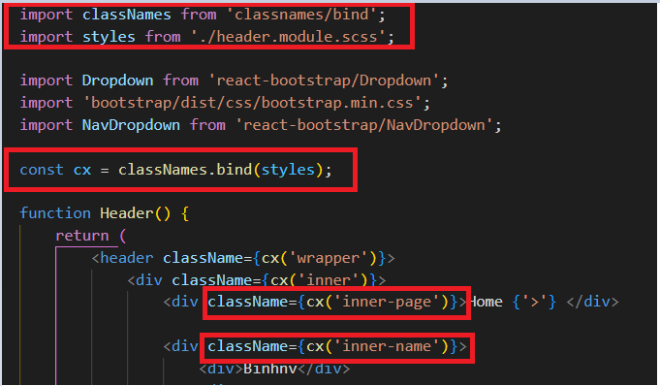
All library in project
Axios
React Bootstrap
Classnames (to be able to name it explicitly without the syntax error of javascript)
Sass
React-dom
React-route-dom
How to use library classNames

Slide 3
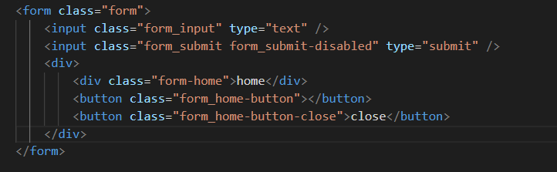
Variable naming rules
Apply BEM. Standard variable naming rules

Slide 4
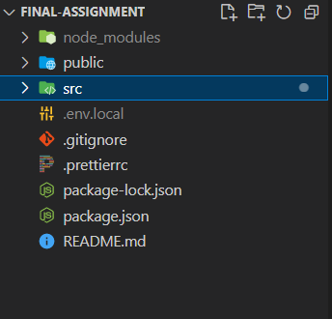
Over view
Main
Node_modules : contains all functions
Public : contains some HTML, JSON and base image files
Src: this is the root of project

Slide 5
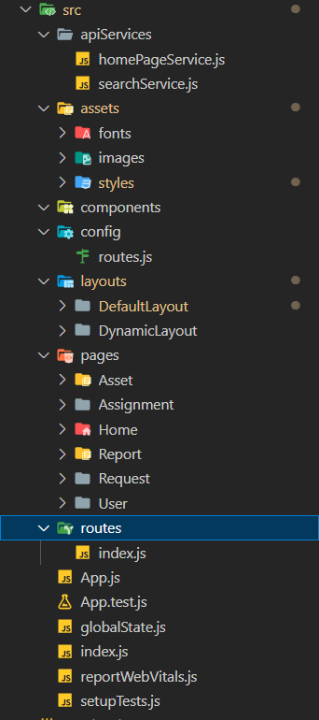
Src
ApiServices
Assets
Components
Config
Layouts
Pages
Routes
Common

Slide 6
ApiServices
Contains the entire api of the project
When using the api, declare it here
And please make it shareable

Slide 7
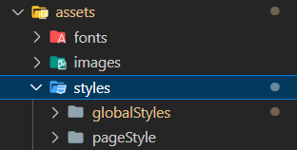
Assets
Contains global image, fonts and css file
Can be used anywhere when called

Slide 8
Components
Contains components, it can be reused when called

Slide 9
Common
Contains everything that can be used in global
And can be used when called anywhere
Config
Configuring parameters and initial settings for the project

Slide 10
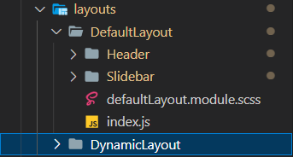
Layouts
Contains elements that are stationary when moving between pages
And dynamic elements (which change when switching pages)

Slide 11
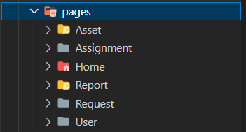
Pages
Contains all the pages of the project

Slide 12
Routes
Contains all route of project in library react-route-dom
Contains routes that can be viewed while not logged in
And route displayed only when logged in.

Slide 13
Other components
Global State
- Contains data that’s transferred from one page to another, converted to global and can be used anywhere

